Slide 1



HACKATHON PROJECT
z
TEAM - 2
GENC TRAINING

Slide 2
TEAM MEMBERS:
Sreelaxmi Muthumala - 935093
Sareddy Anusha - 935184
Kadiam Sai Rohith - 935736
Vilasagaram Pranathi - 935175
Vishnu Vardhan Myakala - 935841

Slide 3

PROJECT TITLE – FINDING HOSPITALS
Get the hospital names .
1
Get Top Cities.
2
Check For Corporate Wellness.
3

Slide 4
Detailed Description
1. For Bangalore city
Identify Hospitals that is Open 24/7.
Has Parking facility with rating more than 3.5.
Display the hospital names
2. In Diagnostics page
Pick all the top cities name & store in a List.
Display the same.
3. Go to Corporate Wellness
Fill invalid details, schedule & capture the warning message from the alert.

Slide 5
About Our Work
Our Work is to inspect the website and automate the module. Our purpose is to test the different functionalities of the system. This includes the following functionalities
1) Search for hospital functionality
2) Top cities
3) Corporate Wellness functionality
Website that we are using – Practo Website

Slide 6
About the Practo Website
Practo is a one-stop for all of a patient's healthcare needs. This specialisation is the most significant and responsible since it provides immediate medical care to those who are suffering. It connects people to everything they need to take care of themselves and their families, including analysing health conditions, locating the correct doctor, scheduling diagnostic testing, accessing medications, and storing medical records.
URL - https://www.practo.com/

Slide 7
How is our work done ?
The script is automated using Selenium with Java Language.
Page Object Model(POM) is used to reduce the code duplication for various instances.
Data obtained from website is stored in Excel Sheet using Apache POI; also, data input is taken from a file with variables written in it.
Our script is in TestNG format.
Project style is Maven project.
Our script has been executed even in Jenkins.

Slide 8
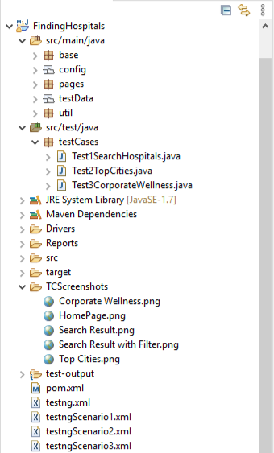
STRUCTURE OF THE PROJECT
z

Slide 9
Steps To Project Execution
z

Slide 10
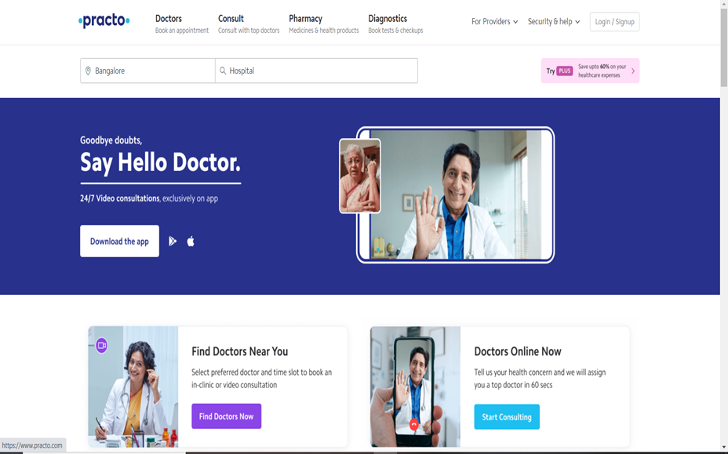
Step 1 : Practo Home page
Homepage of Practo Website

Slide 11
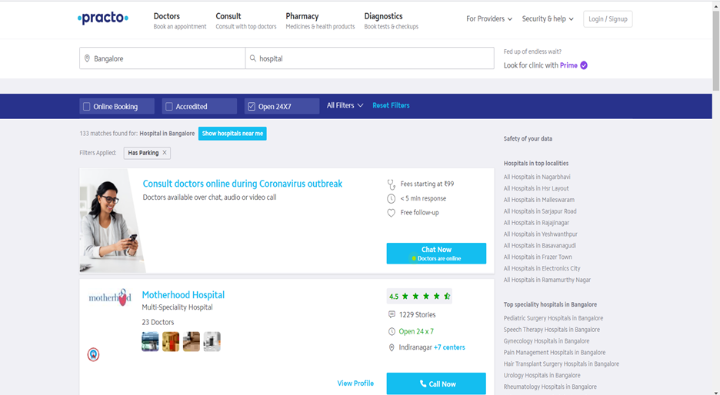
Step 2 : Search results for Hospital
Names of the Hospital in Bangalore city, that is Open 24/7, has Parking facility with rating more than 3.5.

Slide 12
Step 3 : Going back to the Home Page and clicking on Diagnostic Tab
Homepage of Practo Website

Slide 13
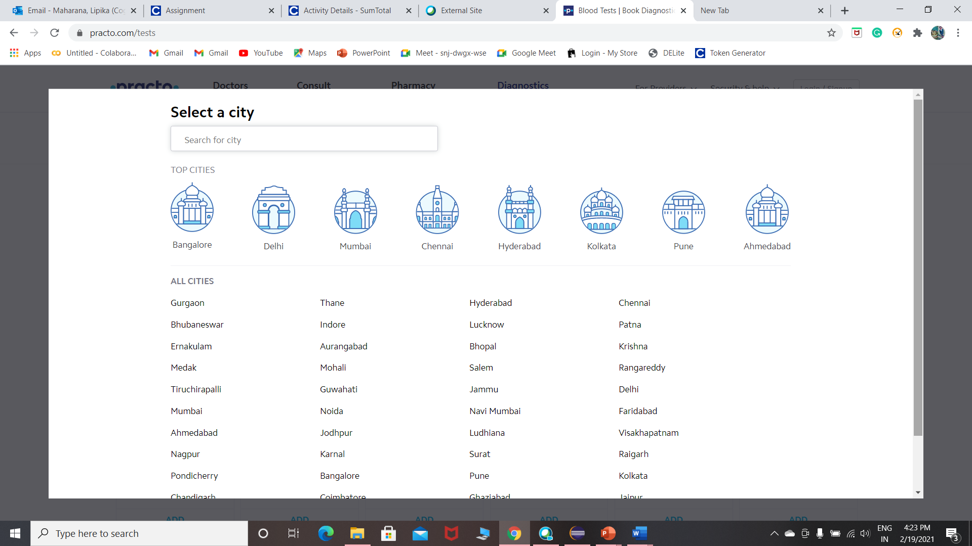
Step 4 : Displaying The Name of Top Cities
Name of all the Top Cities in Diagnostics Page.

Slide 14
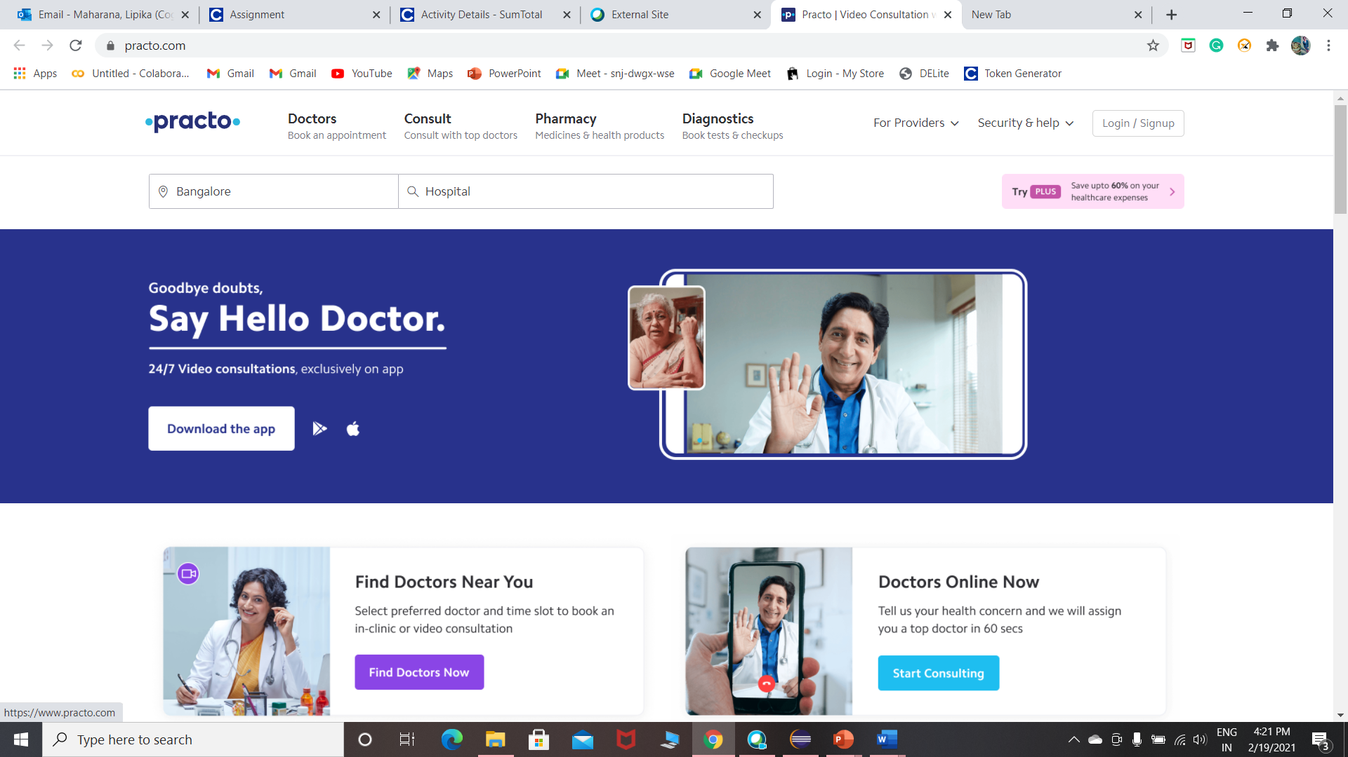
Step 5 : Going back to the Home Page and clicking on For Provider and selecting Corporate Wellness option from the drop-down list
Homepage of Practo Website

Slide 15
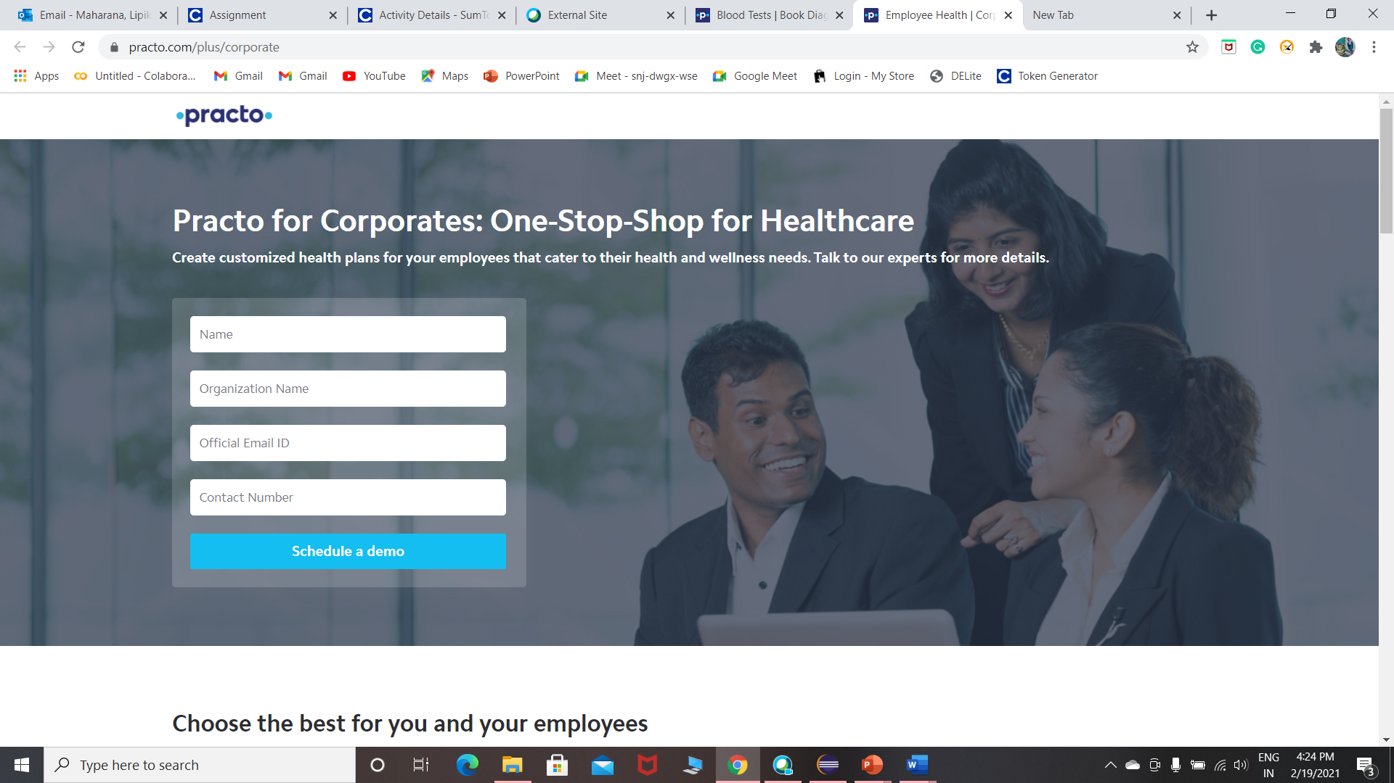
Step 6 : Corporate Wellness page
Corporate Wellness Page

Slide 16
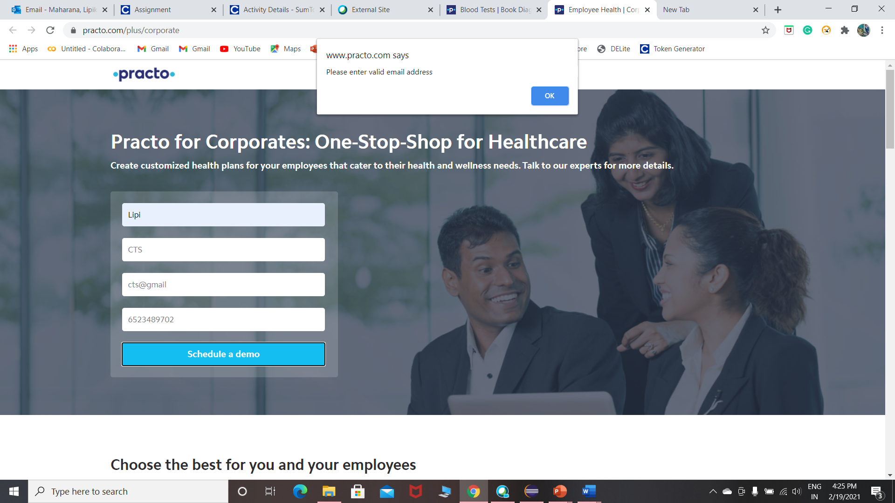
Step 7 : Positive/Alternate Scenario
In Corporate Wellness, warning message from the alert is displayed after filling invalid details in the field or not filling in any field and clicking on Schedule A Demo.

Slide 17
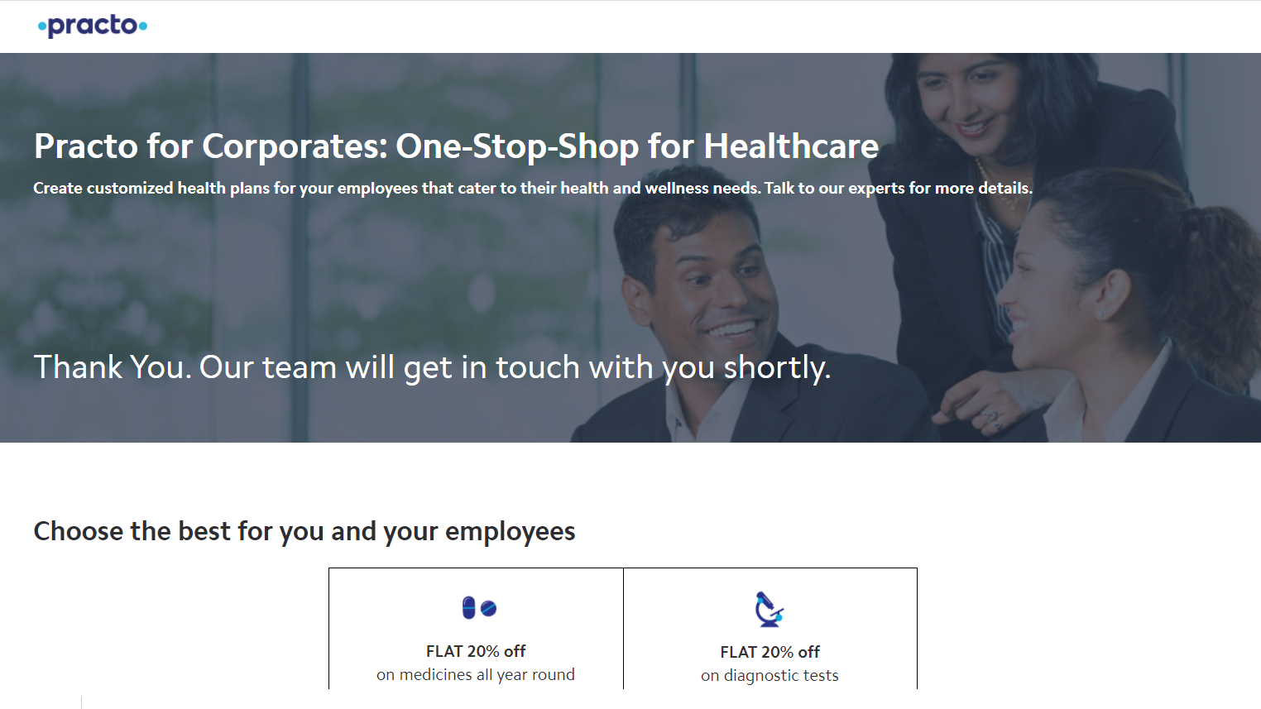
Step 8 : Negative Scenario
In Corporate Wellness, Thank You message is displayed after filling valid details in the fields and clicking on Schedule A Demo.

Slide 18
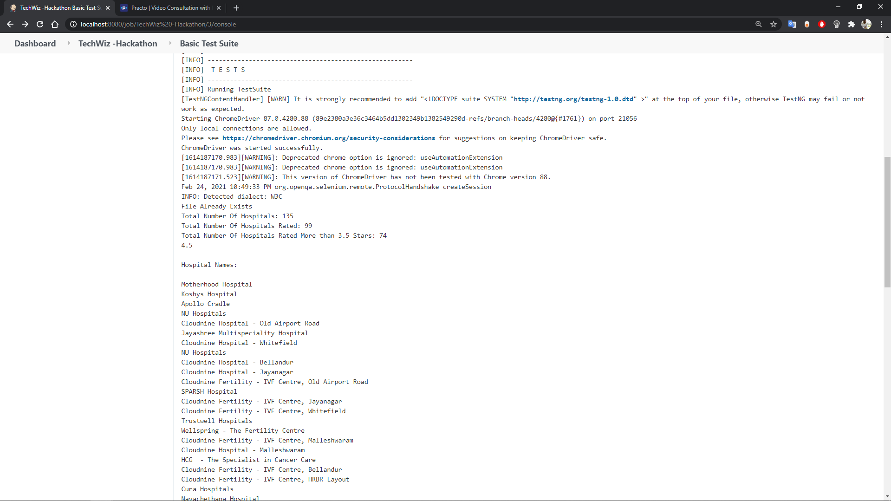
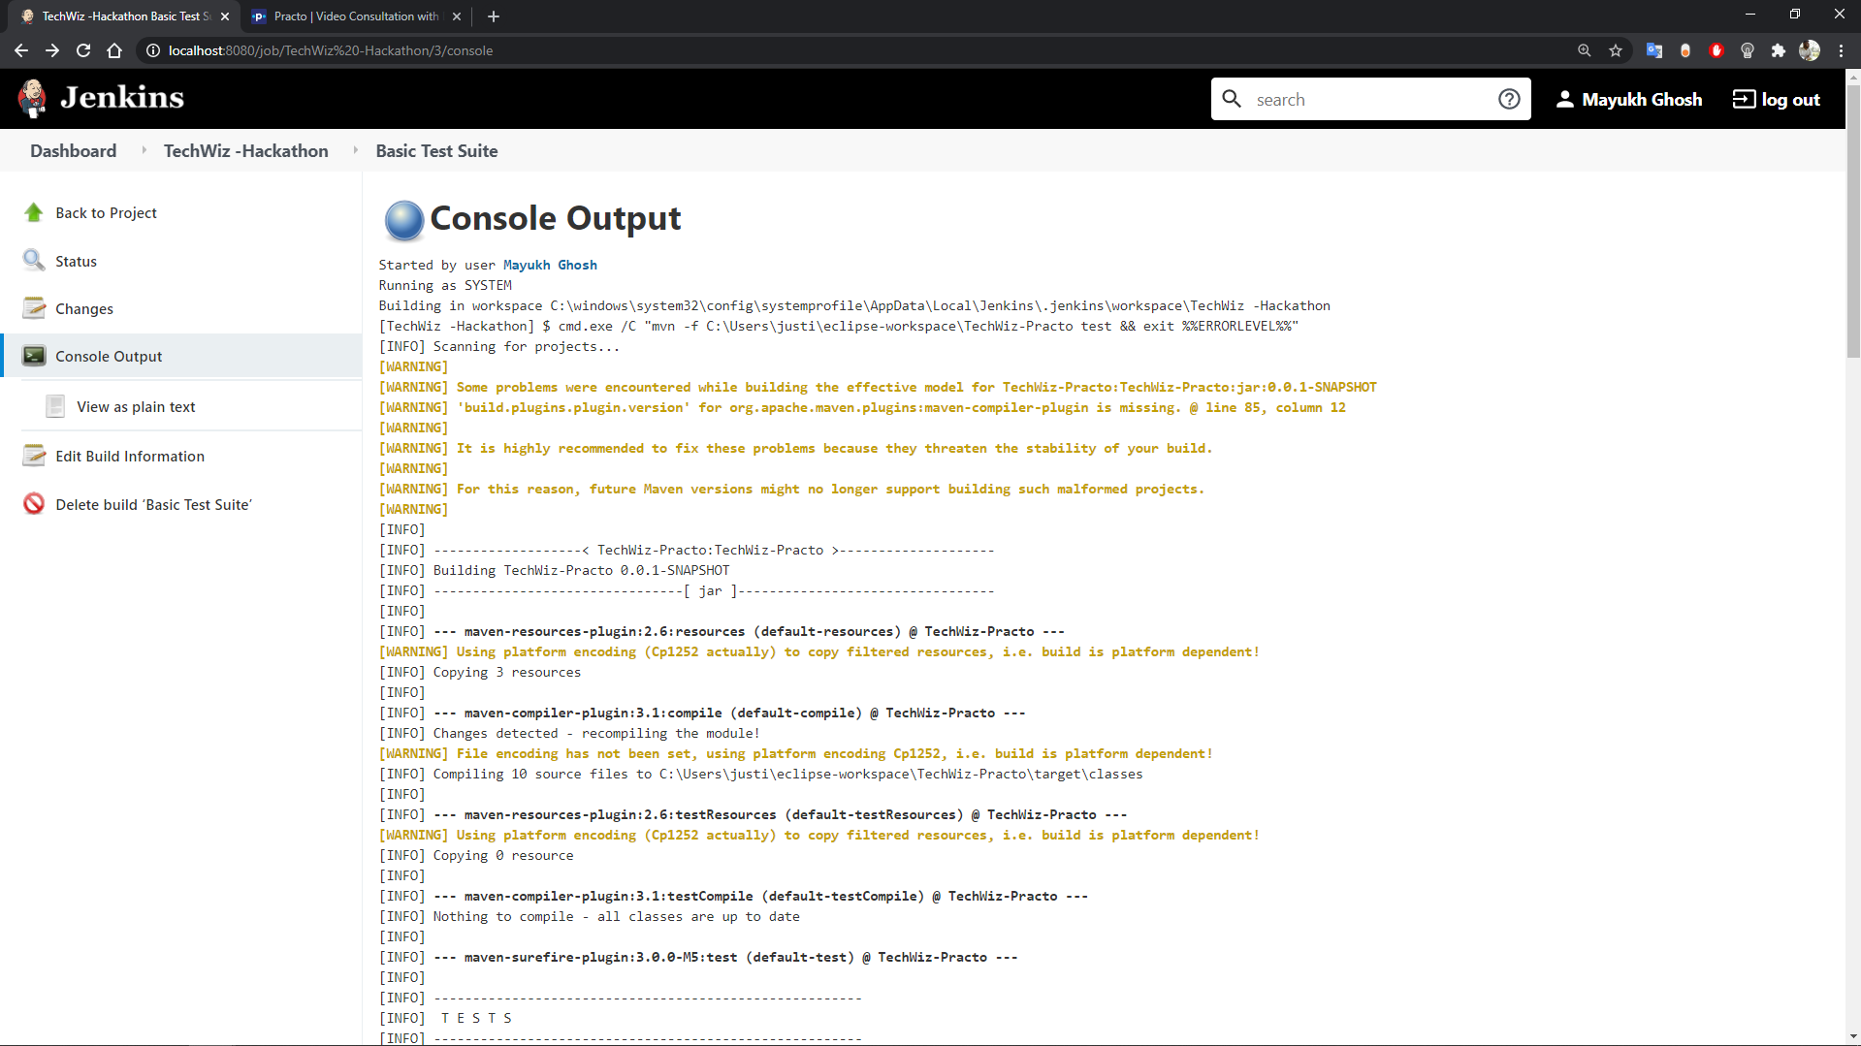
Jenkins Execution
z

Slide 19
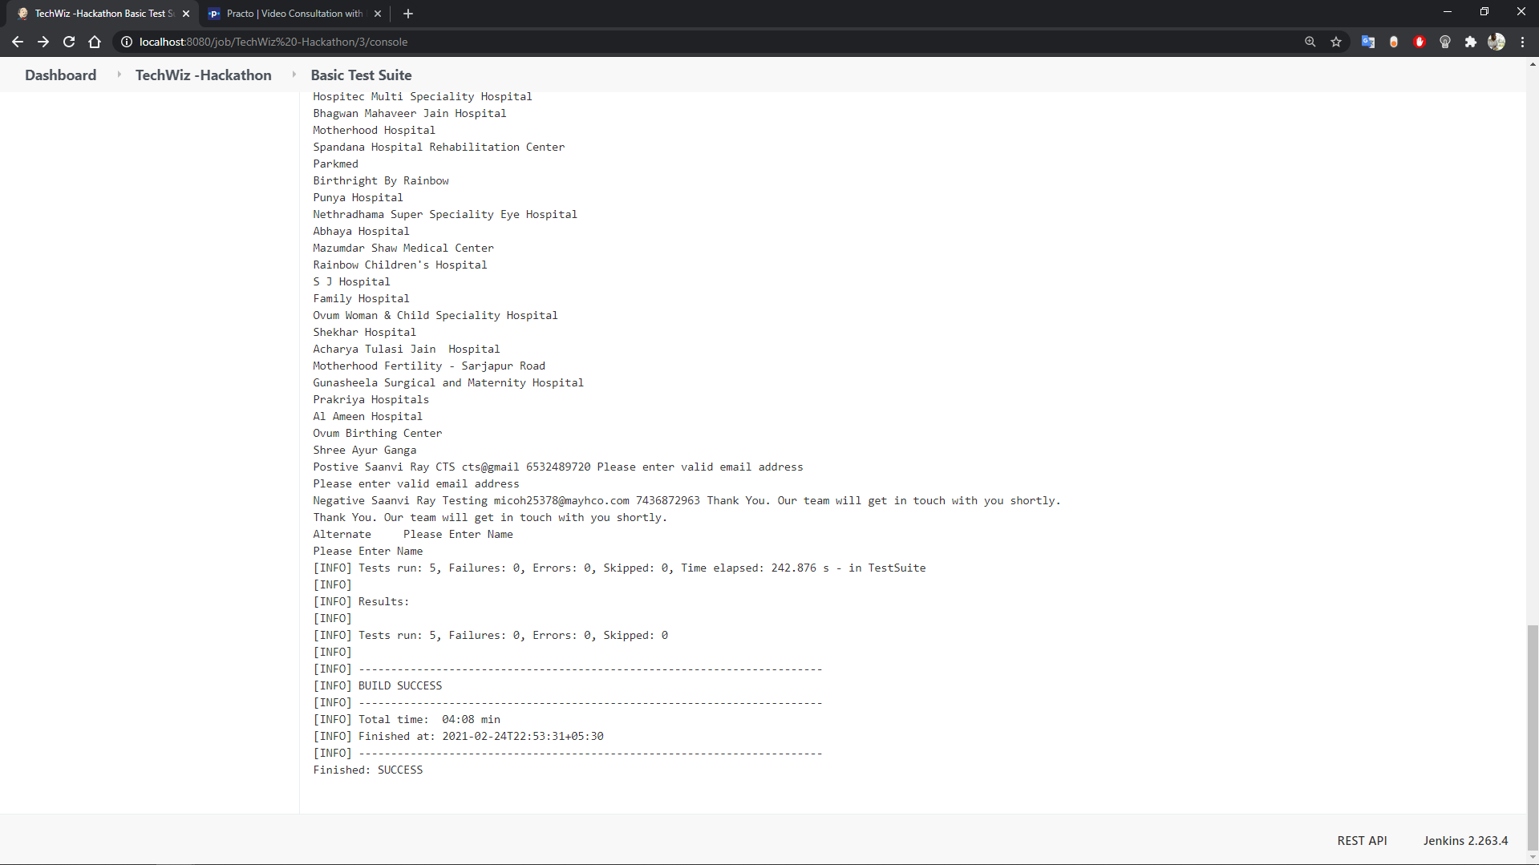
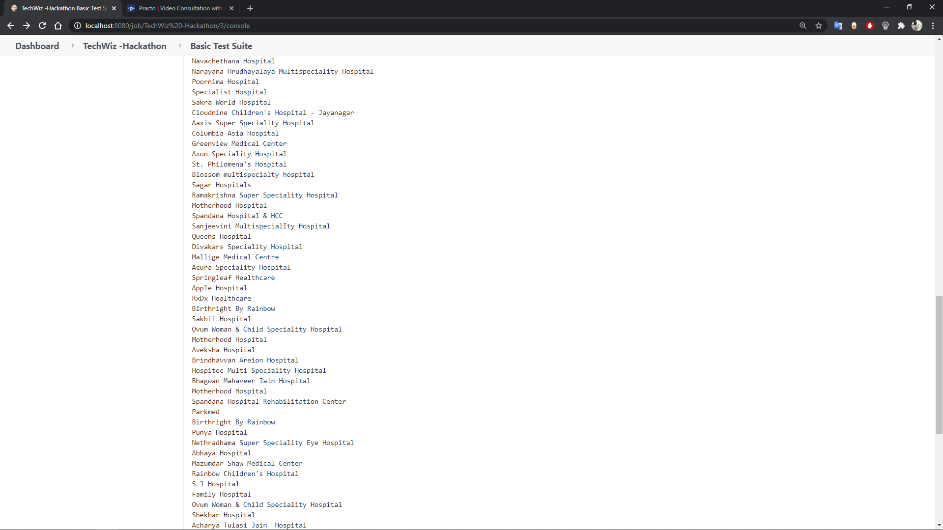
Jenkins Execution
z

Slide 20

THANK YOU
z

